Slide 1
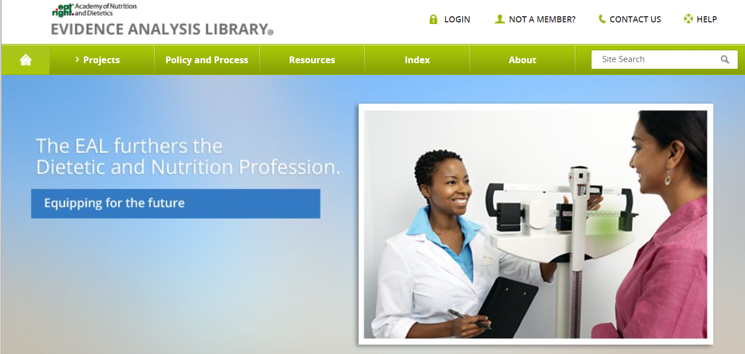
Academy of Nutrition and Dietetics Evidence Analysis Library®
www.andeal.org
Adult Weight Management
Evidence-Based Nutrition Practice Guidelines Executive Summary of Recommendations
Guideline published October 2022

Slide 2
Definition
What is Evidence-based Dietetics Practice?
“Evidence-Based Dietetics Practice is the use of systematically reviewed scientific evidence in making food and nutrition practice decisions by integrating best available evidence with professional expertise and client values to improve outcomes.”
A.N.D. Scope of Dietetics Practice Framework: Approved by A.N.D. House of Delegates
© 2022 A.N.D. Evidence Analysis Library®

Slide 3
Overall Guideline Objective
To provide evidence-based recommendations for dietitians providing behavior change-based nutrition interventions for adults (≥18 years of age) with overweight and obesity to improve cardiometabolic outcomes, quality of life, and weight outcomes, when appropriate for and desired by the client.
© 2022 A.N.D. Evidence Analysis Library®

Slide 4
Target Population
Adults (≥18 years of age)
Male and Female
Target Population Description
Overweight/obese Adults (BMI ≥25 kg/m² or as defined for specific adult populations) including those with cardiometabolic disease such as type 2 diabetes mellitus or cardiovascular disease.
© 2022 A.N.D. Evidence Analysis Library®

Slide 5
Guideline Scope Characteristics
Guideline Category
These recommendations focus on the following major outcomes:
Management
Intervention
Counseling
Clinical Specialty
Family Practice, Geriatrics, Internal Medicine, Nursing, Nutrition, Obstetrics and Gynecology, Physical Medicine and Rehabilitation, Preventive Medicine, Psychiatry, Sports Medicine
© 2022 A.N.D. Evidence Analysis Library®

Slide 6
Statement of Intent
Evidence-based nutrition practice guidelines are developed to help Registered Dietitians, practitioners, patients, families, and consumers make shared decisions about health care choices in specific clinical circumstances. If properly developed, communicated, and implemented, guidelines can improve care.
While the evidence-based nutrition practice guideline represents a statement of promising practice based on the latest available evidence at the time of publication, the guideline is not intended to overrule professional judgment. Rather, it may be viewed as a relative constraint on individual clinician discretion in a particular clinical circumstance. The independent skill and judgment of the health care provider must always dictate treatment decisions. These nutrition practice guidelines are provided with the express understanding that they do not establish or specify particular standards of care, whether legal, medical or other.
© 2022 A.N.D. Evidence Analysis Library®

Slide 7
Disclaimer
While A.N.D. evidence-based nutrition practice guidelines represent a statement of best practice based on the latest available evidence at the time of publishing, they are not intended to overrule professional judgment. Rather, they may be viewed as a relative constraint on individual clinician discretion in a particular clinical circumstance. The independent skill and judgment of the health care provider must always dictate treatment decisions. These nutrition practice guidelines are provided with the express understanding that they do not establish or specify particular standards of care, whether legal, medical or other.
© 2022 A.N.D. Evidence Analysis Library®

Slide 8
Guideline Rating
Each Recommendation is Rated:
Strong,
Weak, or
Consensus
Recommendation statements include terms:
“Recommend/should” (Strong)
“Suggest/may” (Weak)
“It is reasonable” (Consensus)
Each Recommendation Statement is:
Conditional or
Imperative
© 2022 A.N.D. Evidence Analysis Library®

Slide 9
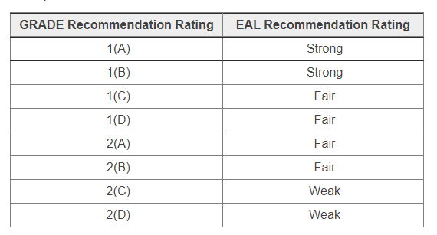
Recommendation Translation
© 2022 A.N.D. Evidence Analysis Library®

Slide 10
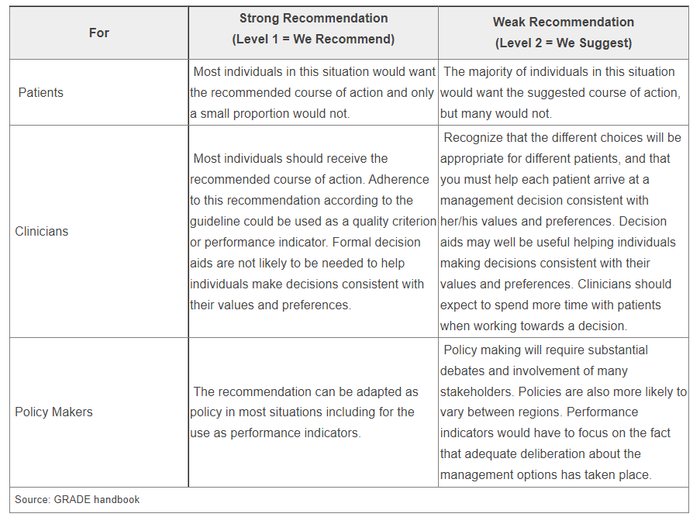
Implications of Strong/Weak Recommendations
© 2022 A.N.D. Evidence Analysis Library®

Slide 11
Conditional/Imperative
Imperative recommendations are broadly applicable to the target population and are stated as “require,” or “must,” or “should achieve certain goals.”
Conditional statements clearly define a specific situation and contain conditional text that would limit their applicability to specified circumstances, or to a sub-population group. More specifically, a conditional recommendation can be stated in if/then terminology.
© 2022 A.N.D. Evidence Analysis Library®

Slide 12
Adult Weight Management Topics
Medical Nutrition Therapy Approach for Adult Overweight and Obesity Management
Coordination of Care
Medical Nutrition Therapy Amount
Delivery of Medical Nutrition Therapy
Payment for Services
Dietary and Lifestyle Intervention Approaches
Special Populations
© 2022 A.N.D. Evidence Analysis Library®

Slide 13
Adult Weight Management
Evidence Based
Nutrition Practice Guideline
Executive Summary of Recommendations
Guideline published October 2022
© 2022 A.N.D. Evidence Analysis Library®

Slide 14
Nutrition Intervention
© 2022 A.N.D. Evidence Analysis Library®

Slide 15
AWM: Utilize the Nutrition Care Process
It is reasonable for registered dietitian nutritionists or international equivalents to utilize the Nutrition Care Process to provide effective, client-centered interventions based on shared decision-making and clinical judgement and individualized to each client’s needs, circumstances, and goals.
Consensus
Conditional
© 2022 A.N.D. Evidence Analysis Library®

Slide 16
AWM: Provide Medical Nutrition Therapy
Medical Nutrition Therapy provided by registered dietitian nutritionists or international equivalents is recommended for adults with overweight or obesity to improve cardiometabolic outcomes, quality of life, and weight outcomes, as appropriate for and desired by each client.
Level 1(B)
Imperative
© 2022 A.N.D. Evidence Analysis Library®

Slide 17
AWM: Adapt Goals and Interventions
It is reasonable for registered dietitian nutritionists or international equivalents to monitor and evaluate client outcomes and adapt goals and interventions, including those for weight maintenance, and provide resources as needed for each client.
Consensus
Conditional
© 2022 A.N.D. Evidence Analysis Library®

Slide 18
AWM: Minimize Weight Bias and Stigma
It is reasonable for registered dietitian nutritionists or international equivalents to minimize the effects of weight bias and weight stigma and its consequences by targeting client-centered goals, individualizing interventions according to complex contributors of overweight and obesity, communicating using client-preferred terms, and providing an inclusive physical environment.
Consensus
Conditional
© 2022 A.N.D. Evidence Analysis Library®

Slide 19
AWM: Collaborate with Interprofessional Healthcare Team
Registered dietitian nutritionists or international equivalents should collaborate with an interprofessional healthcare team to provide comprehensive, multi-component care for adults with overweight or obesity, as appropriate for and desired by each client.
Level 1(C)
Imperative
© 2022 A.N.D. Evidence Analysis Library®

Slide 20
AWM: Coordinate Care in a Variety of Settings
Registered dietitian nutritionists or international equivalents providing medical nutrition therapy interventions for adults with overweight and obesity should coordinate care in a variety of settings, including primary care/outpatient, community and workplace settings, to access and support each client with resources in the environment that best suits individualized needs.
Level 1(B)
Imperative
© 2022 A.N.D. Evidence Analysis Library®

Slide 21
AWM: Number and Frequency of Interactive Contacts
Registered dietitian nutritionists or international equivalents may provide at least five interactive sessions, when feasible and desired by each adult client with overweight or obesity, to achieve the greatest potential improvement in outcomes. Frequency of contacts should be tailored to each client’s preferences and needs.
Level 2(C)
Conditional
© 2022 A.N.D. Evidence Analysis Library®

Slide 22
AWM: Intervention Duration
Registered dietitian nutritionists or international equivalents should provide overweight and obesity management interventions for a duration of at least one year to improve and optimize cardiometabolic and weight outcomes, as appropriate for and desired by each client.
Level 1(C)
Conditional
© 2014 A.N.D. Evidence Analysis Library®

Slide 23
AWM: Follow-Up Contacts
Following completion of overweight and obesity management interventions, registered dietitian nutritionists or international equivalents should provide follow-up contacts at least every three months, for as long as desired by each client, to facilitate maintenance of weight loss and improved cardiometabolic outcomes.
Level 1(C)
Conditional
© 2022 A.N.D. Evidence Analysis Library®

Slide 24
AWM: Telehealth and In-Person Care
Registered dietitian nutritionists or international equivalents may use telehealth, in-person contacts, or a blend of these delivery methods when providing MNT interventions to adults with overweight or obesity. Outcomes may be optimized by including in-person contacts.
Level 2(C)
Conditional
© 2022 A.N.D. Evidence Analysis Library®

Slide 25
AWM: Group and Individual Contacts
Registered dietitian nutritionists or international equivalents may use both individual and group delivery methods when providing MNT interventions to adults with overweight or obesity, as feasible and appropriate for each client.
Level 2(C)
Conditional
© 2022 A.N.D. Evidence Analysis Library®

Slide 26
AWM: Payment for Services
It is reasonable and necessary for registered dietitian nutritionists or international equivalents to be aware of and utilize existing channels of payment for services for adults with overweight or obesity to improve client access to care.
Consensus
Conditional
© 2022 A.N.D. Evidence Analysis Library®

Slide 27
AWM: Dietary Patterns
Registered dietitian nutritionists or international equivalents should advise adult clients with overweight or obesity that many different dietary patterns can be individualized to support client-centered goals. Prescribed dietary approaches should achieve and maintain nutrient adequacy and be realistic for client adherence. Prescribed calorie levels should be tailored based on estimated or measured needs and should be adjusted to improve weight outcomes, as appropriate for and desired by each client.
Level 1(C)
Imperative
© 2022 A.N.D. Evidence Analysis Library®

Slide 28
AWM: Components of a Comprehensive Intervention
Registered dietitian nutritionists or international equivalents should advise the following components as part of a comprehensive adult overweight and obesity management intervention to improve cardiometabolic outcomes, quality of life, and weight outcomes, as appropriate for and desired by each client:
Nutritionally adequate diet with adjusted calories to improve weight outcomes and a nutritionally adequate, energy-balanced diet for weight maintenance;
Behavioral strategies, including self-monitoring (diet, physical activity, weight);
Appropriate physical activity to meet client goals (within the RDN’s scope of practice or referral to an exercise practitioner).
Level 1(C)
Imperative
© 2022 A.N.D. Evidence Analysis Library®

Slide 29
AWM: Co-Morbidities
Registered dietitian nutritionists or international equivalents should collaborate with clients and healthcare teams to manage co-morbidities such as type 2 diabetes mellitus, cardiovascular disease, dyslipidemia and other potential complications associated with overweight or obesity by tailoring MNT to each client’s specific health care needs, including medications, while supporting weight loss.
Level 1(B)
Imperative
© 2022 A.N.D. Evidence Analysis Library®

Slide 30
AWM: Pharmacotherapy and Metabolic and Bariatric Surgery
Adults with obesity who receive pharmacotherapy or metabolic and bariatric surgery should collaborate with registered dietitian nutritionists or international equivalents, as part of an interprofessional healthcare team, to improve and maintain a healthy diet that meets nutritional needs and advances weight-loss efforts to improve cardiometabolic outcomes.
Level 1(B)
Imperative
© 2022 A.N.D. Evidence Analysis Library®

Slide 31
AWM: Members of Groups Disproportionately affected by Overweight or Obesity and Under-Resourced Communities
For adults who are members of groups disproportionately affected by overweight or obesity, or under-resourced communities (e.g., adults with low socioeconomic status, adults from racial or ethnic minority groups, older adults, adults with disabilities), registered dietitian nutritionists or international equivalents should provide culturally appropriate interventions that are tailored to each client’s values, beliefs and barriers regarding excess weight, and food and physical activity behaviors.
Level 1(C)
Imperative
© 2022 A.N.D. Evidence Analysis Library®

Slide 32
No Implied Endorsement
No endorsement by the Academy of Nutrition and Dietetics of any brand-name product or service is intended or should be inferred from a Guideline or from any of its components (including Question, Evidence Summary, Conclusion Statement, Conclusion Statement Grade, Recommendation or Recommendation Rating).
Evidence-based Nutrition Practice Guidelines are intended to serve as a synthesis of the best evidence available to inform registered dietitians as they individualize nutrition care for their clients. Guidelines are provided with the express understanding that they do not establish or specify particular standards of care, whether legal, medical or other.
Evidence-based Nutrition Practice Guidelines are intended to summarize best available research as a decision tool for A.N.D. members.
© 2022 A.N.D. Evidence Analysis Library®

Slide 33
Guideline Implementation
Information and Resources

Slide 34
Tools
The “Considerations for Application” section of each guideline recommendation includes tools and expert advice on implementation.
To assist nutrition and dietetics professionals with implementing evidence-based practice recommendations and clinical practice innovations into daily practice, the Academy developed Implementing Evidence: From Guidelines to Daily Practice. Download it from: www.andeal.org/guideline-implementation
© 2022 A.N.D. Evidence Analysis Library®

Slide 35
AWM Guideline Resources (click on links)
Nutrition Care Process for Overweight and Obesity Figure
Interprofessional Team Figure
Dietary Approaches Table
IDEA Table
Academy of Nutrition and Dietetics 2022 Standards of Practice and Standards of Professional Performance (JAND 2022 122(10):1940-1954:E45)
Nutrition Care Manual (subscription required)
Academy of Nutrition and Dietetics Scope of Practice Decision Algorithm
IDEA Resource
Intensive Behavioral Therapy for Obesity
Payment Guidance
National Organization of Blacks in Dietetics and Nutrition Member Resource Library
USDA MyPlate for Adults
© 2022 A.N.D. Evidence Analysis Library®

Slide 36
Guideline Development

Slide 37
Guideline Methods
The methodology for this project was developed using the process of the Academy of Nutrition and Dietetics,^{1,2} in accordance with the Standards for Developing Clinical Practice Guidelines from the National Academy of Science using grading and guideline development tools from the GRADE (Grading of Recommendations Assessment, Development and Evaluation) group.^{3,4}
Visit the EAL for the complete AWM guideline methods.
Handu D, Moloney L, Wolfram T, Ziegler P, Acosta A, Steiber A. Academy of Nutrition and Dietetics Methodology for Conducting Systematic Reviews for the Evidence Analysis Library. J Acad Nutr Diet. 2016;116(2):311-318.
Papoutsakis C, Moloney L, Sinley RC, Acosta A, Handu D, Steiber AL. Academy of Nutrition and Dietetics Methodology for Developing Evidence-Based Nutrition Practice Guidelines. J Acad Nutr Diet. 2017;117(5):794-804.
The GRADE Working Group. GRADE handbook for grading quality of evidence and strength of recommendations. Cochrane Collaboration. https://gdt.gradepro.org/app/handbook/handbook.html. Published 2013. Updated October 2013.
Collaboration TC. Cochrane Handbook for Systematic Reviews of Interventions Version 5.1.0 [updated March 2011]. . In: Higgins JPT GSe, ed.

Slide 38
Adult Weight Management (2022) Team
Expert Panel Workgroup
Maria E. Morgan-Bathke, MBA, PhD, RDN, CD, FAND, Chair
Suzanne Domel Baxter, PhD, RD, LD, FADA, FAND
Tanya M. Halliday, PhD, RD
Amanda I. Lynch, PhD, RDN
Neal G. Malik, DrPH, MPH, RDN, CHES, ACSM-EP
Hollie A. Raynor, PhD, RDN
Project Leaders
Mary R. Rozga, PhD, RDN, Project Manager
Jessica Garay, PhD, RDN, CSCS, FAND, Lead Analyst
Deepa Handu, PhD, RDN, Methodologist
Amanda Wanner, MLIS, AHIP, Information Specialist
Visit the EAL for workgroup member affiliations and potential conflict of interest disclosures.
© 2022 A.N.D. Evidence Analysis Library®

Slide 39
Major Recommendations
This presentation consisted of the Executive Summary of Recommendations for the Academy of Nutrition and Dietetics Adult Weight Management (AWM) Evidence-Based Nutrition Practice Guideline.
The Major Recommendations and more detail (including the evidence analysis supporting these recommendations) is available for free to Academy members and EAL subscribers.
www.andeal.org
© 2022 A.N.D. Evidence Analysis Library®

Slide 40
For additional information:
Academy of Nutrition and Dietetics Evidence Analysis Library®
^{www.andeal.org}
© 2022 A.N.D. Evidence Analysis Library®

