Slide 1
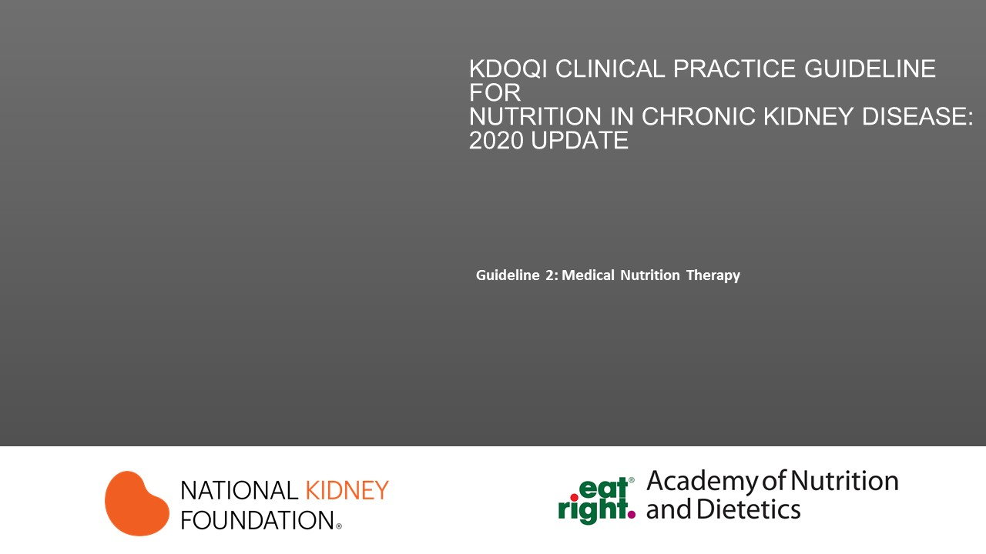

Slide 2
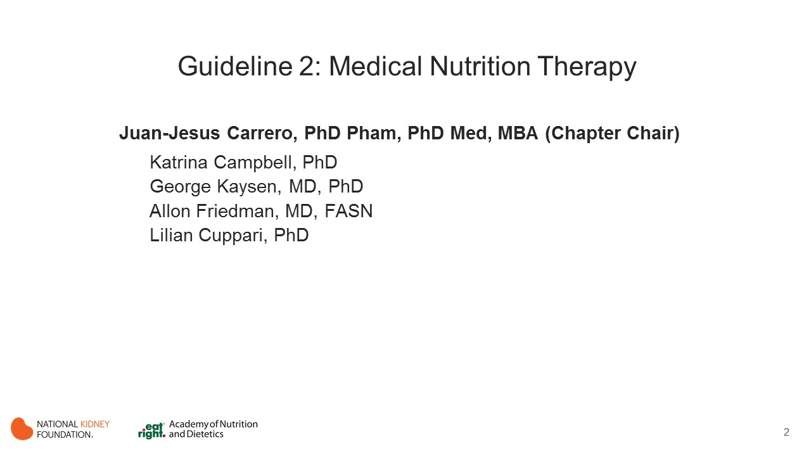
Notes:
Chapter Chair: Jesus Carrero, PhD Pharm, PhD Med, MBA
Chapter Committee:
Katrina Campbell, PhD (MNT section reviewer)
George Kaysen, MD, PhD
Allon Friedman, MD, FASN
Lilian Cuppari, PhD (MNT section author)

Slide 3
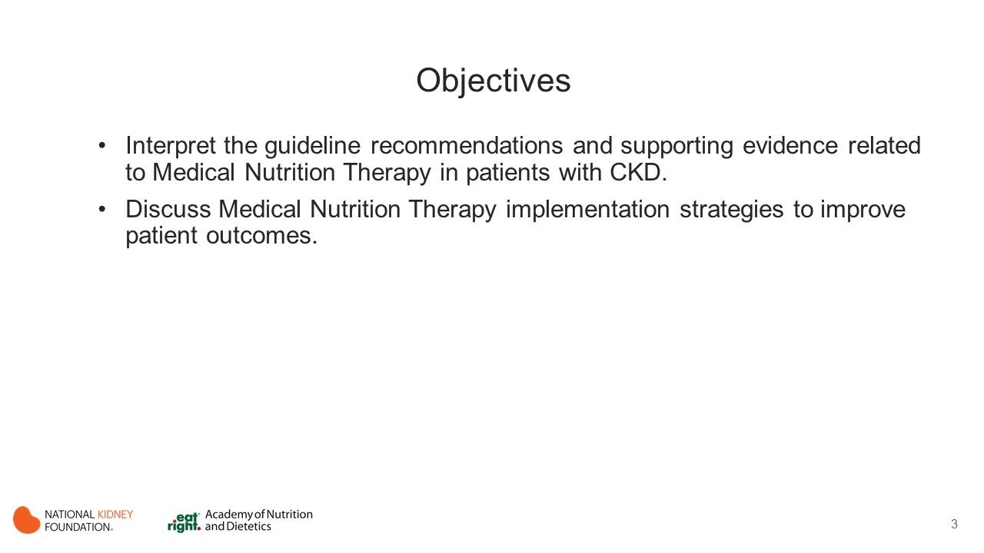
Notes:
The learning objectives for this activity are to:
Interpret the guideline recommendations and supporting evidence related to protein and energy intake in patients with CKD.
Discuss implementation strategies for best clinical practices.

Slide 4
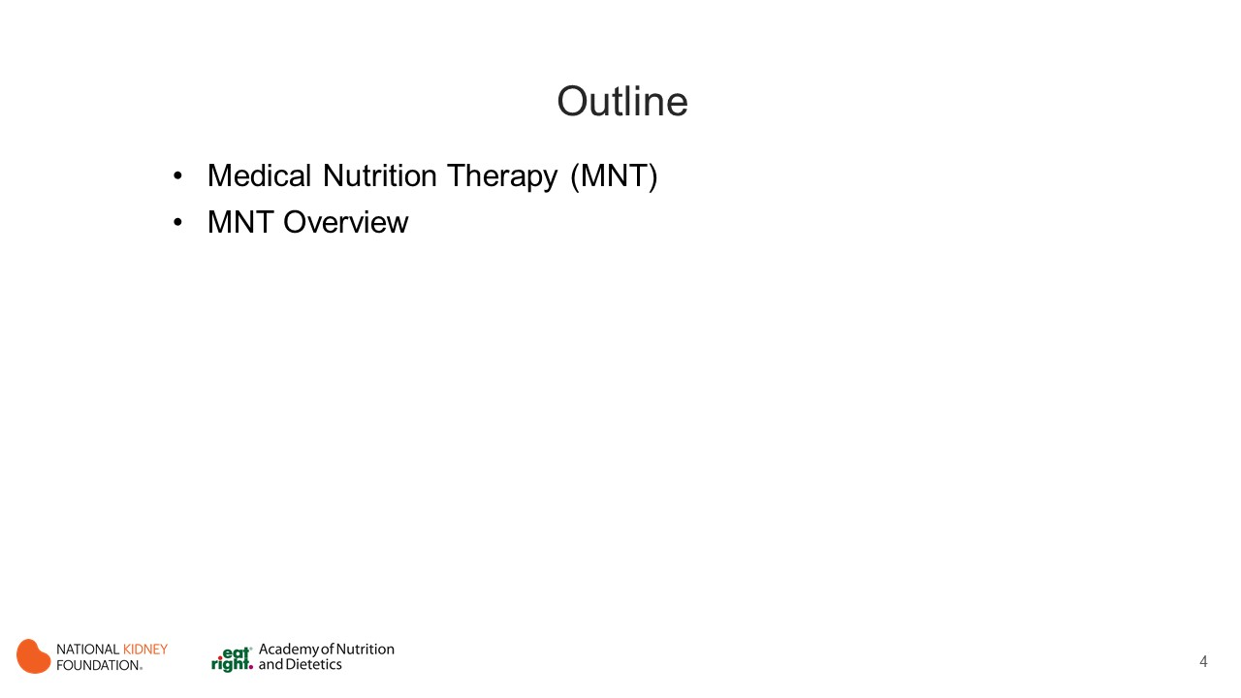
Notes:
Sections
Protein Amount
Energy Intake
Protein Type
Dietary Patterns

Slide 5
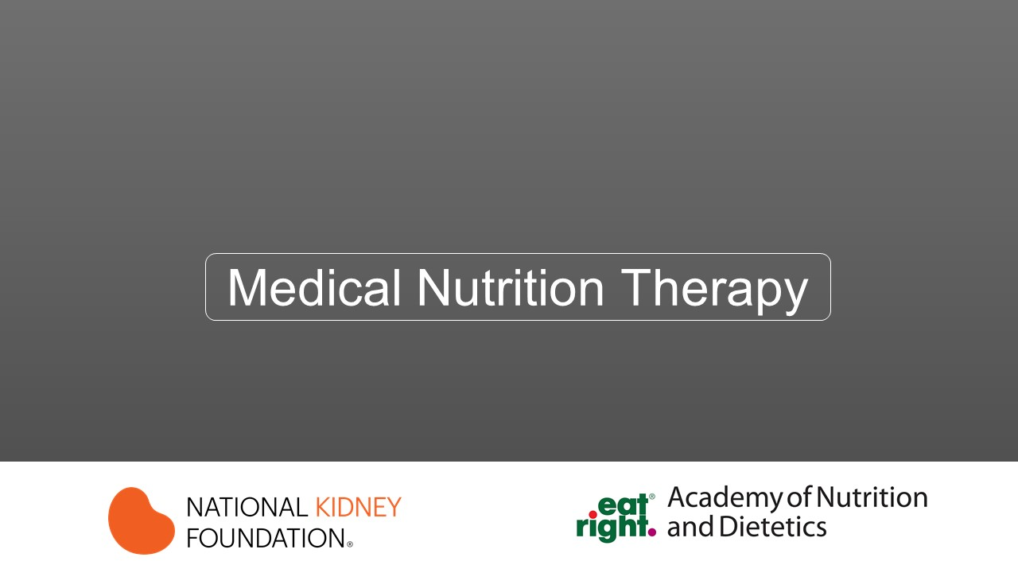

Slide 6
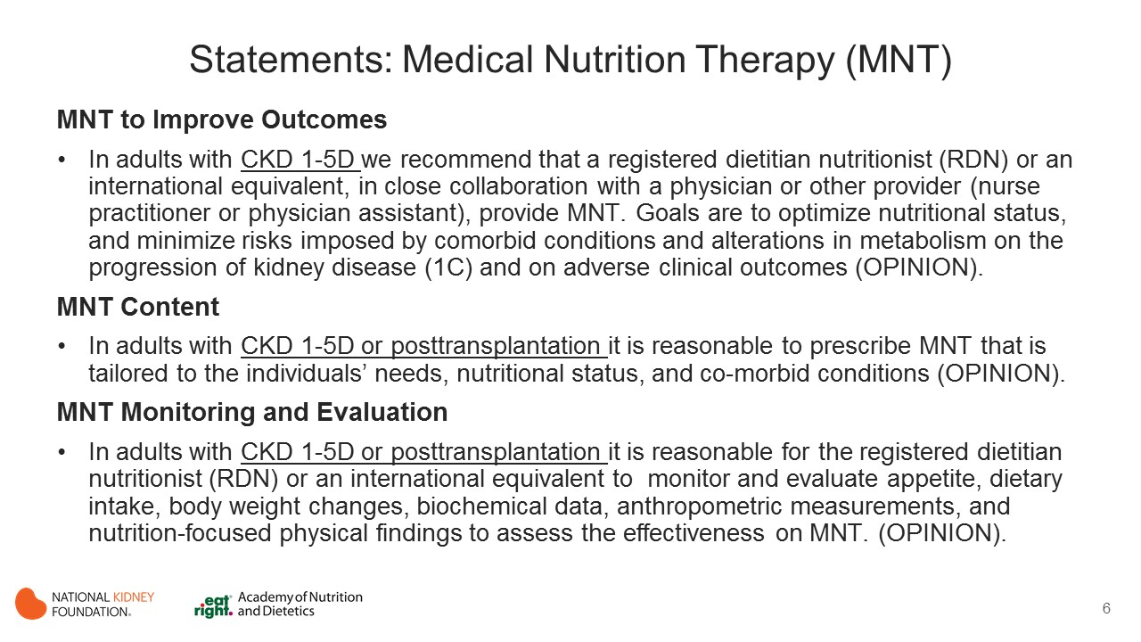
Notes:
Individualized management of nutritional intake is a crucial aspect of care for individuals diagnosed with any stage of CKD, including those receiving maintenance dialysis and those who have received a kidney transplant.
These patients are vulnerable for nutritional abnormalities, which are associated with higher risk for morbidity, mortality, and length of hospital stay. Nutritional needs change throughout the disease course, from the earlier stages of CKD to the posttransplant period.
The metabolic abnormalities and comorbid diseases that often accompany CKD further emphasize the need for specialized nutrition health care.
It is essential that such individuals receive tailored nutrition assessment and counseling in the form of MNT. MNT is a collaborative approach that typically requires the medical expertise and prescription of MNT by a physician or other provider (nurse practitioner or physician assistant) and implementation by an RDN (or international equivalent).
MNT requires nutrition screening and assessment of nutritional status to provide individualized treatment for specific disease states. Patients with CKD are on a dynamic nutrition trajectory according to their disease stage and MNT is needed at each stage of CKD. Metabolic abnormalities and acid-base and fluid and electrolyte balances often change as CKD progresses.

Slide 7
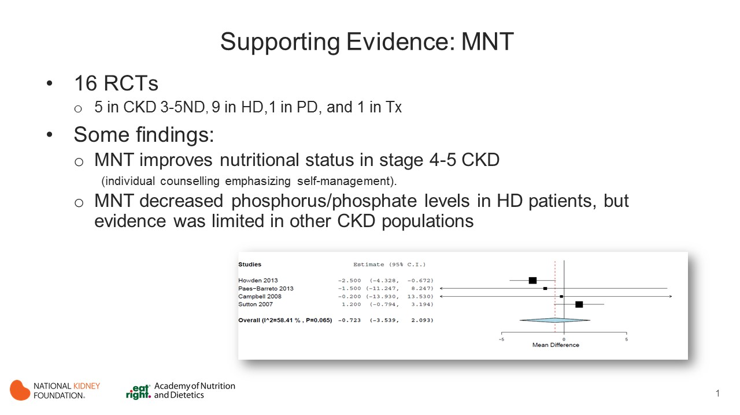
Notes:
Sixteen RCTs examining the effect of MNT on nutrition related outcomes were identified in the systematic review (See Table S7 supplemental material).
These studies were heterogeneous in terms of the populations; 5 studies included patients who were nondialyzed (Campbell 2008, Howden 2013, Paes-Barreto 2013, Fiesher 2011, Howden 2013); 9 included patients receiving MHD (Karavetian 2013, Leon 2006, Lou 2012, Sevick 2016, Akpele 2004, Hernandez-Morante 2014, Ashurst 2003, Morey 2008, Campbell 2008); 1 included patients receiving CAPD (Sutton 2007); and 1 included patients posttransplant (Orazio 2011) interventions (e.g. RDNs used various methods of nutritional counseling among the studies), and outcomes (e.g. protein intake, serum phosphate level, serum albumin level, BMI, and dyslipidemia).
Intervention durations ranged from 4 weeks to 2 years.

Slide 8
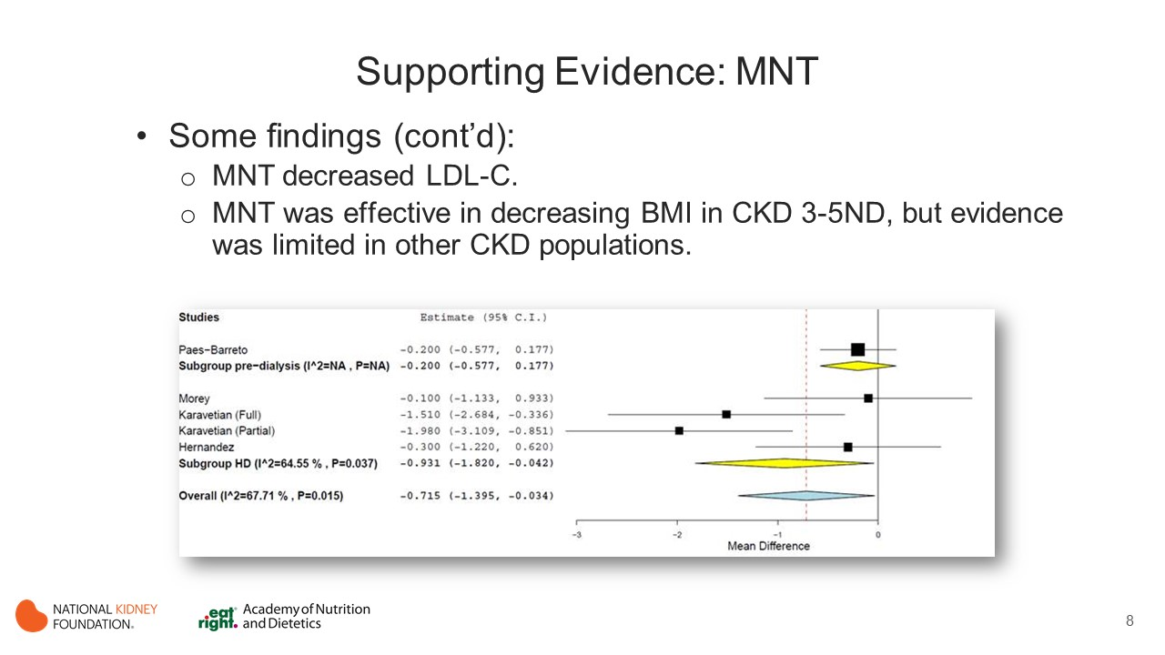

Slide 9
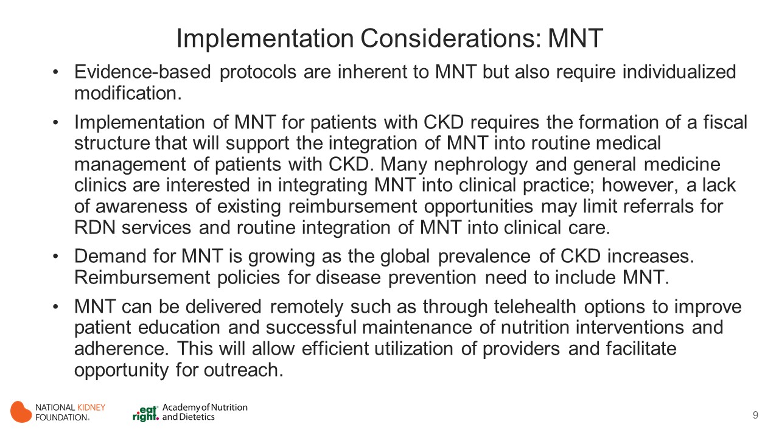
Notes:
The full utility and value of MNT provided by the RDN on both nutrition outcomes and risk for morbidity, mortality, and hospitalizations has not yet been fully identified.
The impact of the RDN in many disease states and the value of repeated contacts with an RDN on specific nutrition parameters has been documented in the literature. This is particularly true for patients with CKD, as well as in other disease states and metabolic phenotypes such as obesity that affect CKD risk and exacerbation of CKD progression.
Although MNT outcomes research is still in its infancy, the studies that exist exhibit important relationships on nutrition parameters and other outcomes.
An MNT database that monitors MNT intervention effectiveness on nutrition and overall outcome parameters would enable the formalization of this analysis.
Studies that prove causality or significant association between MNT application and patient outcomes are currently in progress.
In addition, the strength of the evidence in the studies reviewed prohibits strong recommendations due to the variability in study populations, protocols, and analyses. Therefore, this section included recommendations that are mostly opinion based.

Slide 10


Slide 11
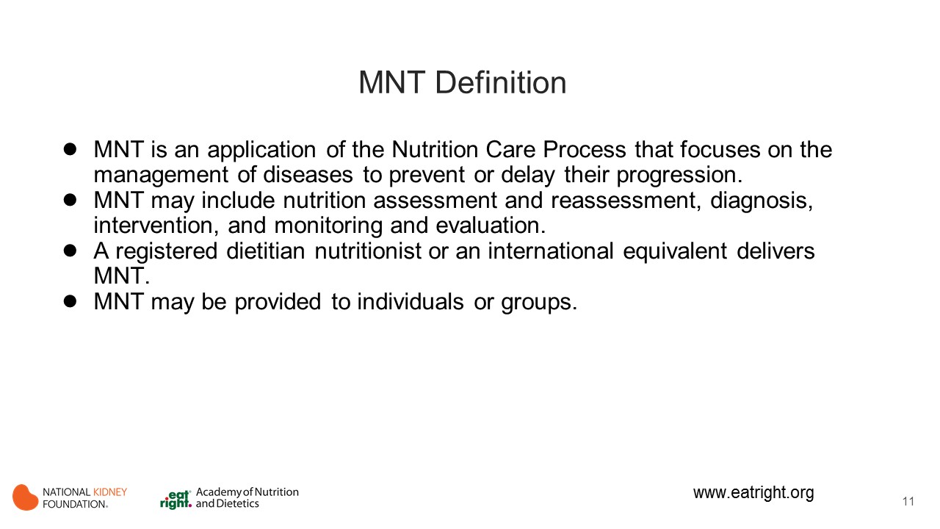
Notes:
In 2002, the American Dietetic Association published the nutrition care model to provide evidence-based care for patients with CKD. This has been updated to specify that this nutritional care be provided by a RDN.
MNT will provide necessary parameters to delay the progression of CKD in addition to managing comorbidities such as diabetes, cardiovascular disease, dyslipidemia, gout and nephrolithiasis.
MNT will be customized and follow up planned when possible to assess the success of implementation.

Slide 12
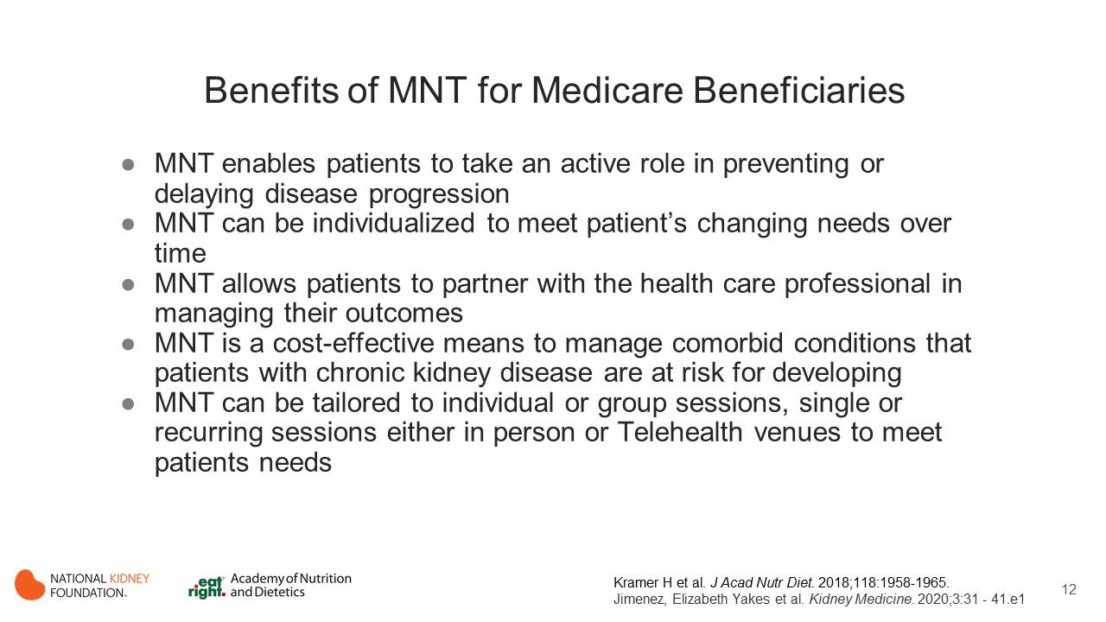
Notes:
The information on this slide is anecdotal in contrast to the focus on evidence-base in the beginning of the slide set.
You may hide this slide if you do not wish to include it in this presentation.

Slide 13
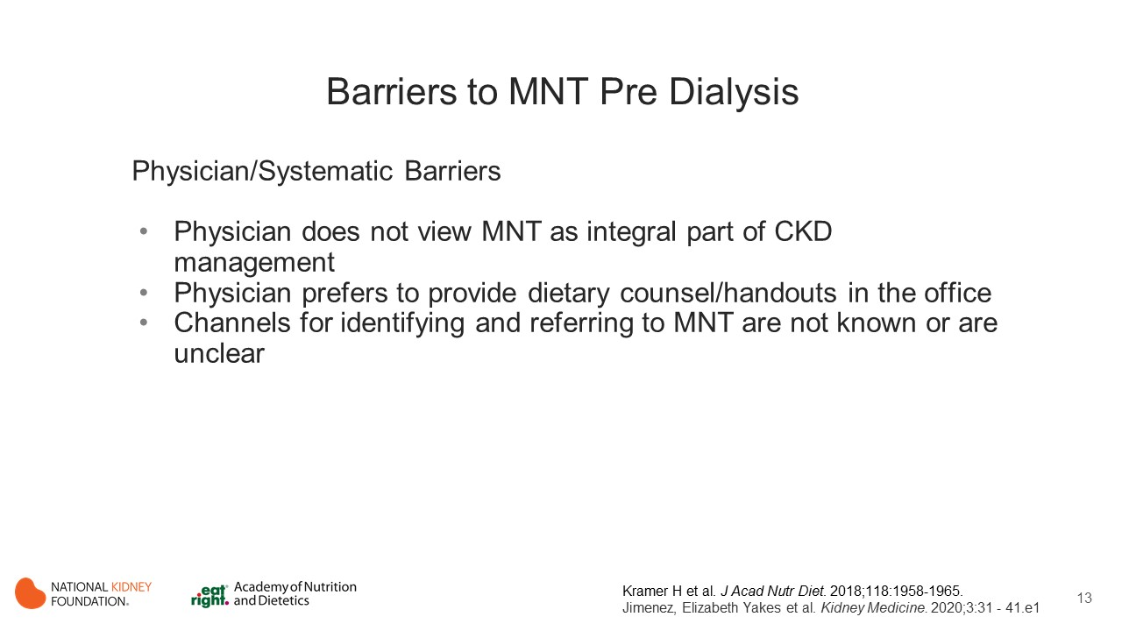
Notes:
The information on this slide is anecdotal in contrast to the focus on evidence-base in the beginning of the slide set.
You may hide this slide if you do not wish to include it in this presentation.

Slide 14
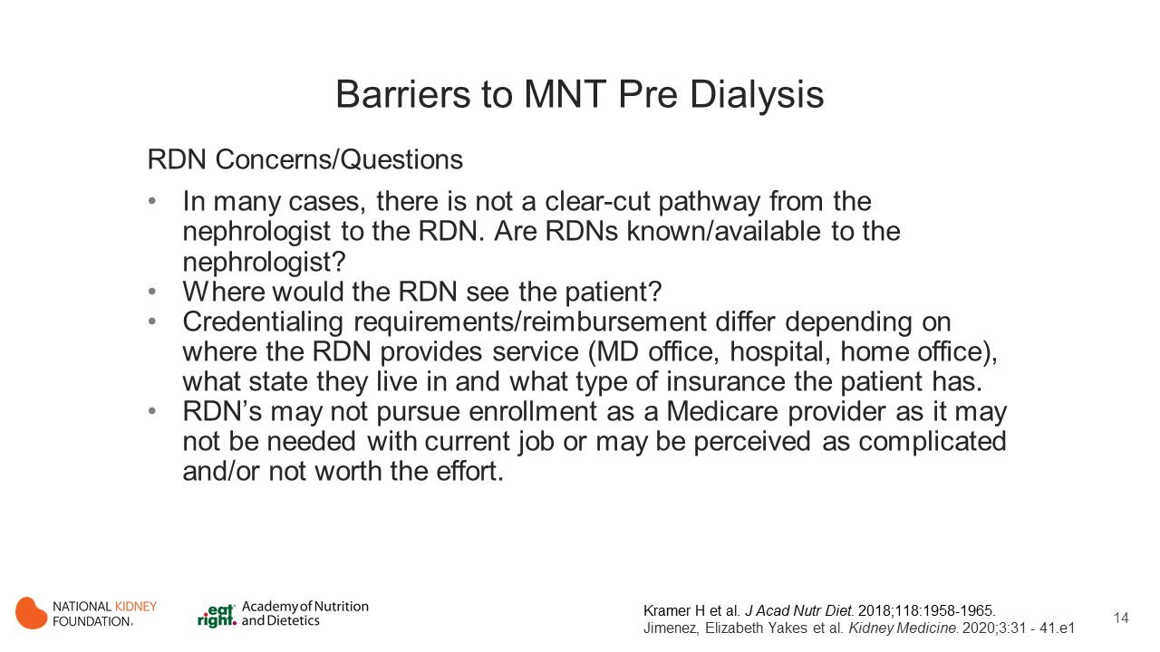
Notes:
The information on this slide is anecdotal in contrast to the focus on evidence-base in the beginning of the slide set.
You may hide this slide if you do not wish to include it in this presentation.

Slide 15
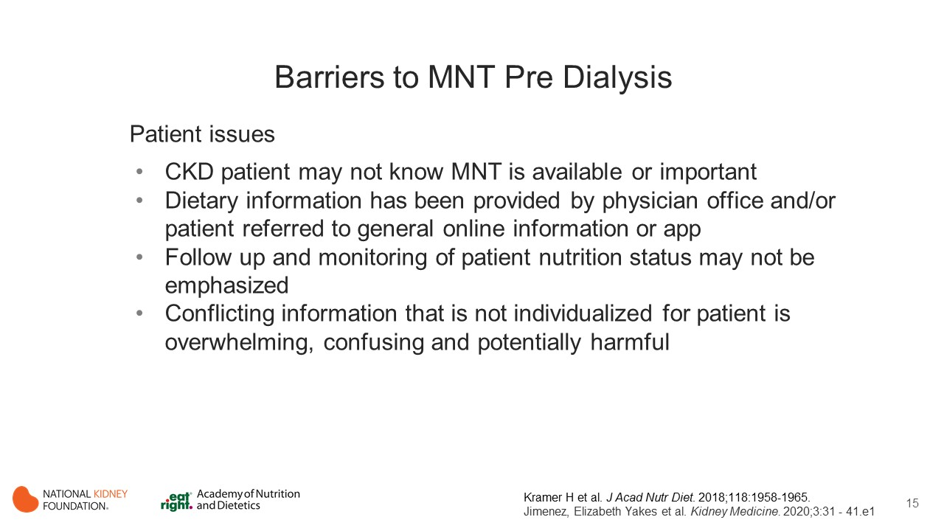
Notes:
The information on this slide is anecdotal in contrast to the focus on evidence-base in the beginning of the slide set.
You may hide this slide if you do not wish to include it in this presentation.

Slide 16
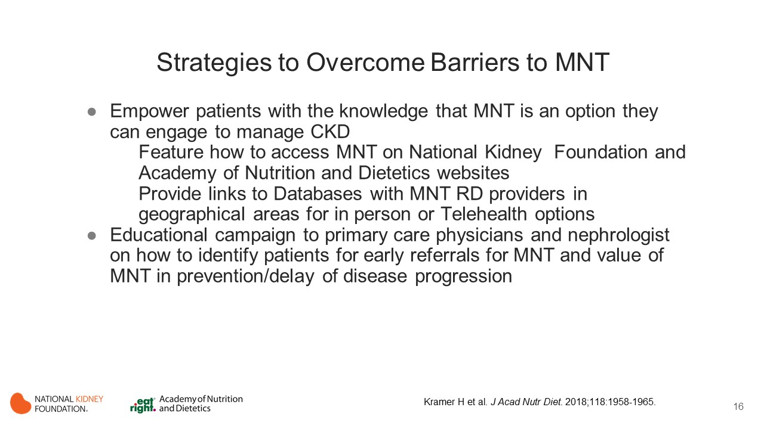
Notes:
The information on this slide is anecdotal in contrast to the focus on evidence-base in the beginning of the slide set.
You may hide this slide if you do not wish to include it in this presentation.

Slide 17
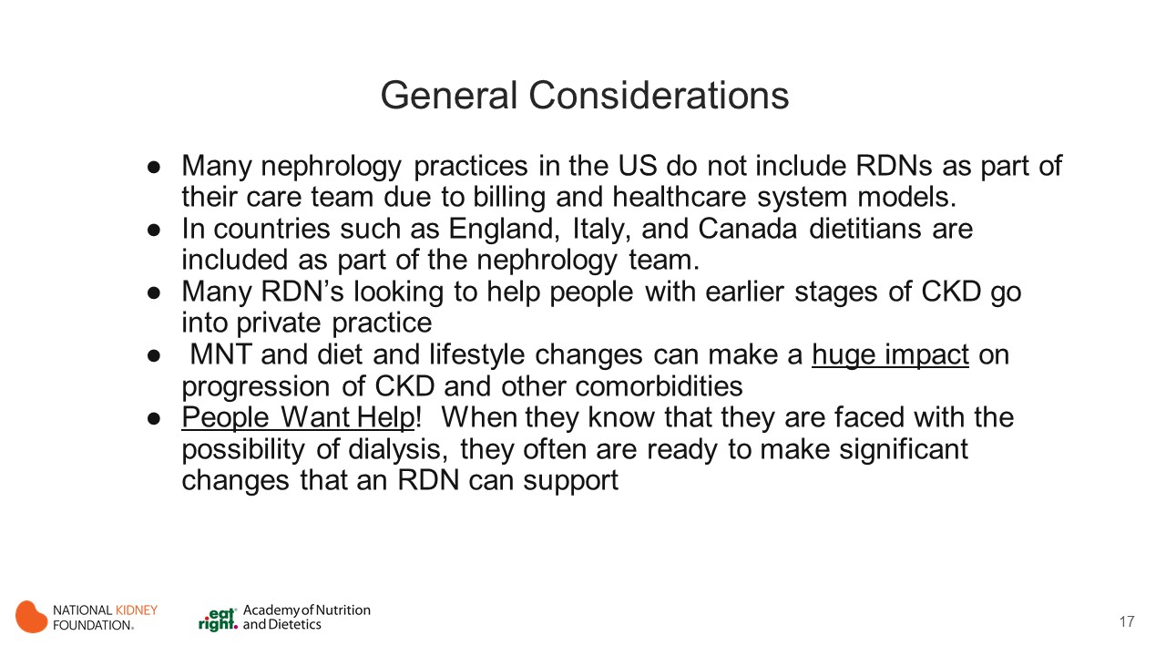
Notes:
The information on this slide is anecdotal in contrast to the focus on evidence-base in the beginning of the slide set.
You may hide this slide if you do not wish to include it in this presentation.

Slide 18
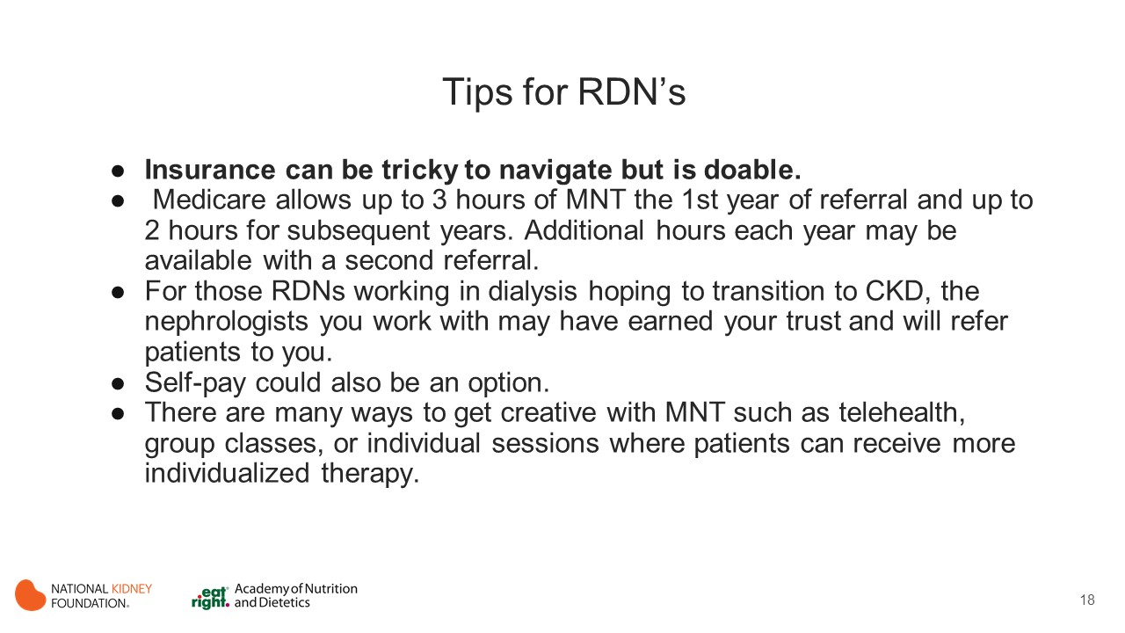

Slide 19
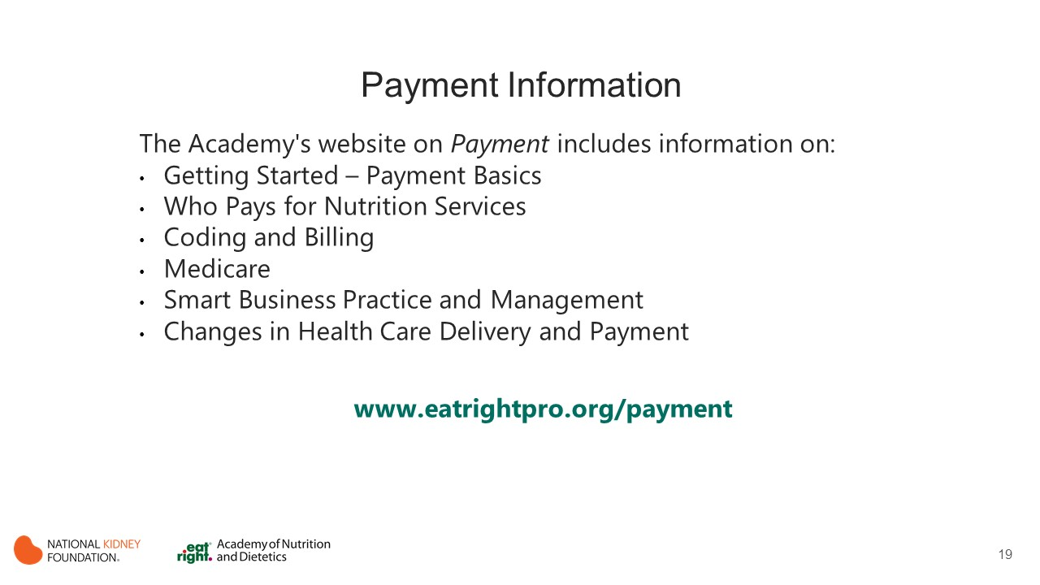
Notes:
The Academy’s (Academy of Nutrition and Dietetics) website content on Payment (www.eatrightpro.org/payment) includes information on:
Getting Started – Payment Basics
Who Pays for Nutrition Services
Coding and Billing
Medicare
Smart Business Practice and Management
Changes in Health Care Delivery and Payment

Slide 20
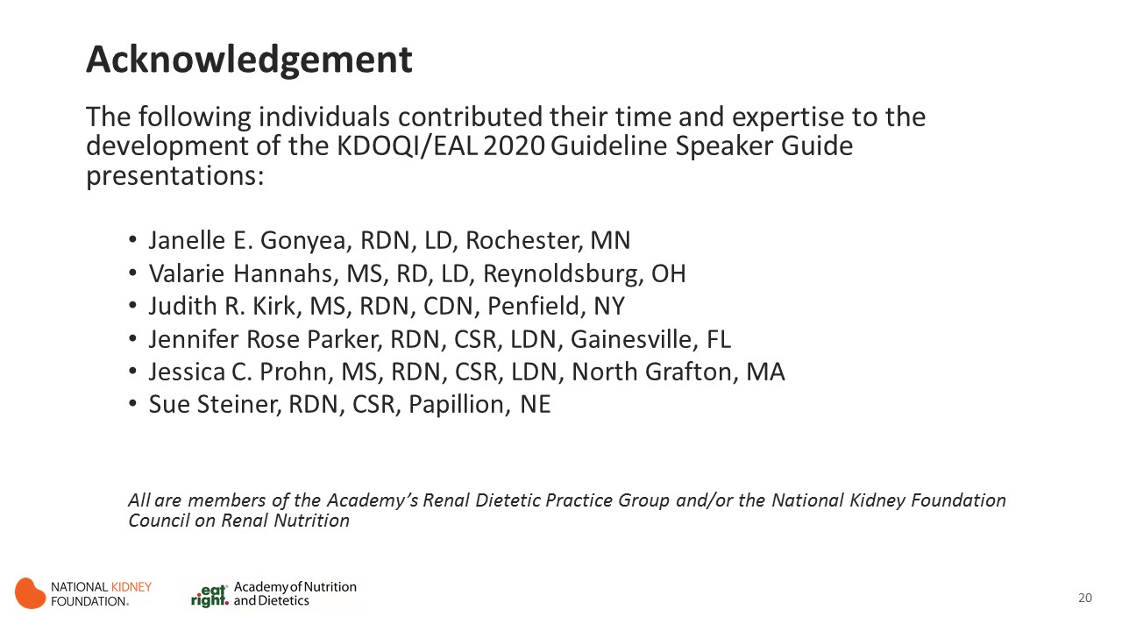

Slide 21
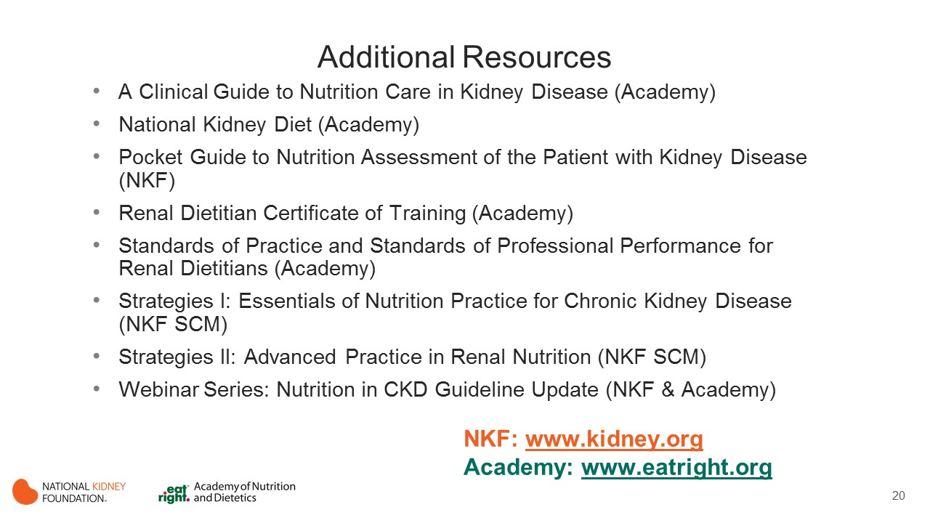
Notes:
These resources from the Academy of Nutrition and Dietetics and the National Kidney Foundation provide additional information to support implementation of the KDOQI Guideline for Nutrition in CKD.
For NKF resources go to kidney.org
For Academy resources go to eatright.org

Slide 22


